Slide 1

Presentation I
Intel® RealSense™ LiDAR Camera L515
Thu Ta Zaw
2415121095

Slide 2

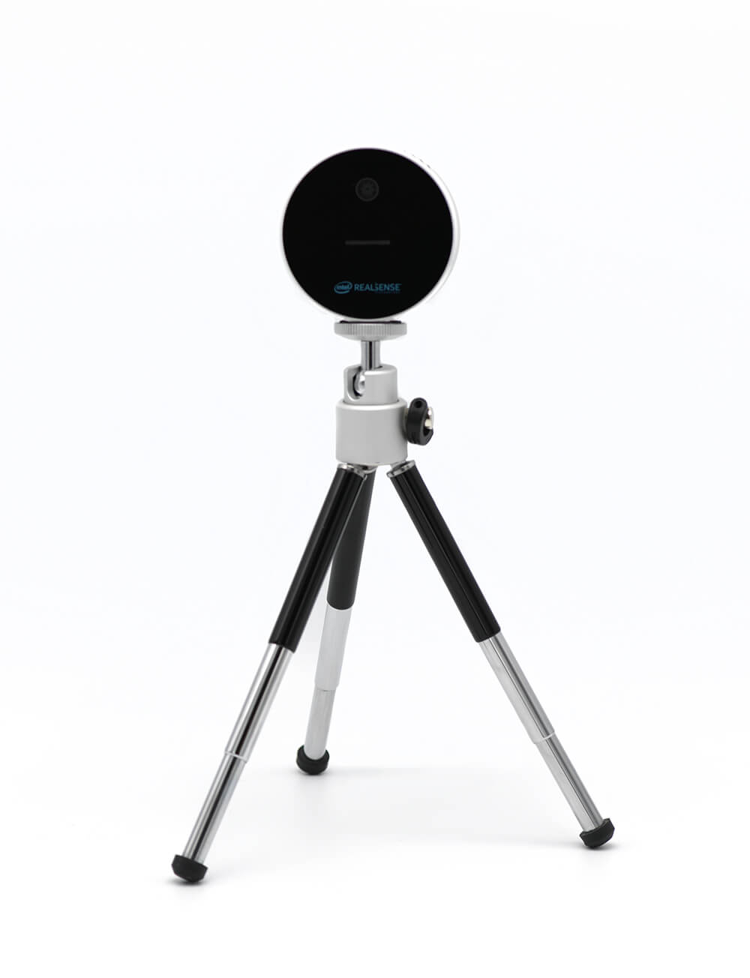
Intel® RealSense™ LiDAR Camera L515
61 mm diameter.
26 mm height.
100 g weight.
Minimum range 0.25 m.
Maximum range 9 m.
Resolution of up to 1024x768 (XGA) at 30 FPS for depth capturing over 23 million depth points per second.
IMU sensor and RGB camera for motion tracking.
5
Light source
Wavelength
Infrared (IR) laser in the range of 844 nm to 875 nm
Laser Type
Class 1 laser, meaning it is considered safe under normal operating conditions, as it poses no harm to human eyes.
Pulse Duration and Repetition Rate
Pulse duration of 1 nanosecond (ns) contributes to its ability to capture fast-moving objects without significant motion blur.
The repetition rate of the laser is 500 MHz.
Laser Power
The maximum power output is 240 mW

Slide 3
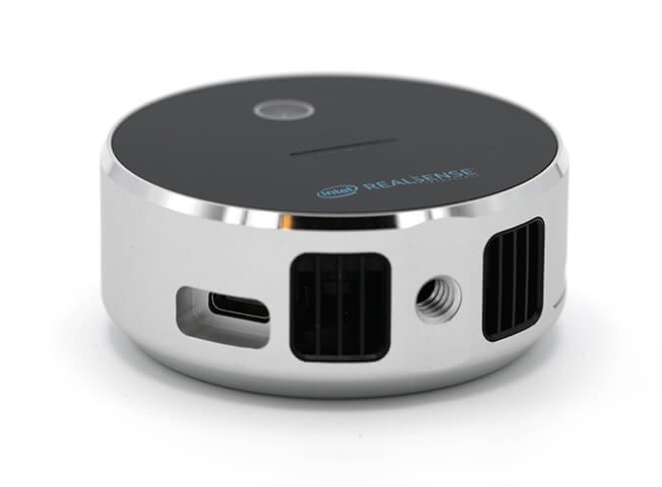
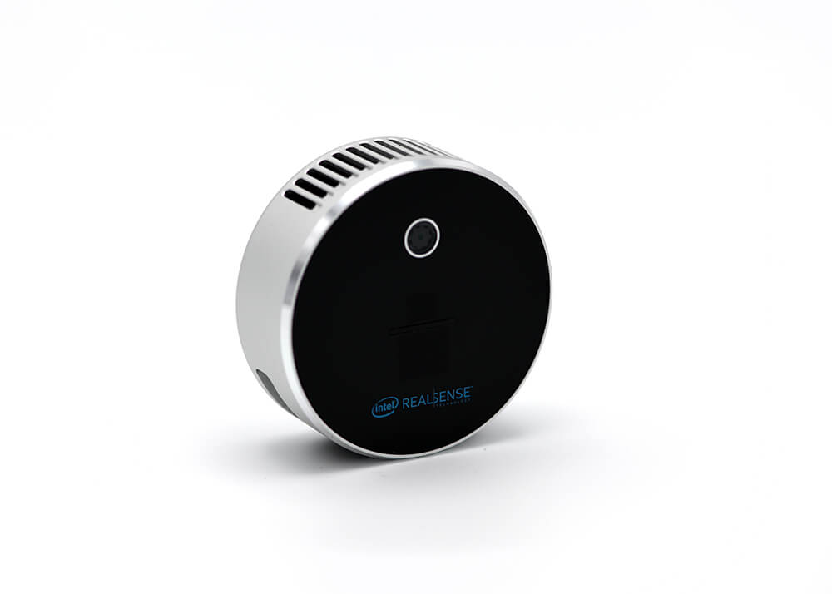
Intel® RealSense™ LiDAR Camera L515
Use Infrared (IR) laser in the range of 844 nm to 875 nm wavelength.
The Pulse duration of 1 nanosecond (ns) contributes to its ability to capture fast-moving object without significant motion blur.
It has repetition rate of 500 MHz.
It is safe for human eyes as it uses class 1 laser.
5

Slide 4




Libraries and packages
Use pyrealsense2 package by the realsense to gather data and process.
For numerical operations and array manipulations
For image processing
For working with 3D point clouds
For data visualization and plotting
4

Slide 5
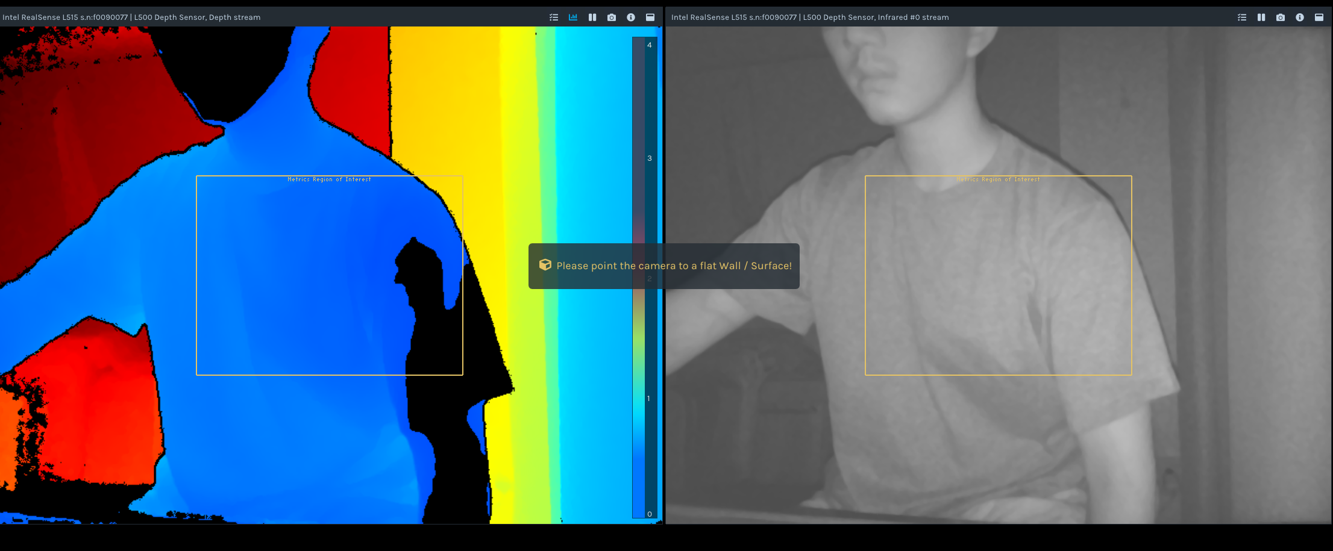
2D output from Realsense
Fig. 2D color and depth view of the realsense viewer
9

Slide 6
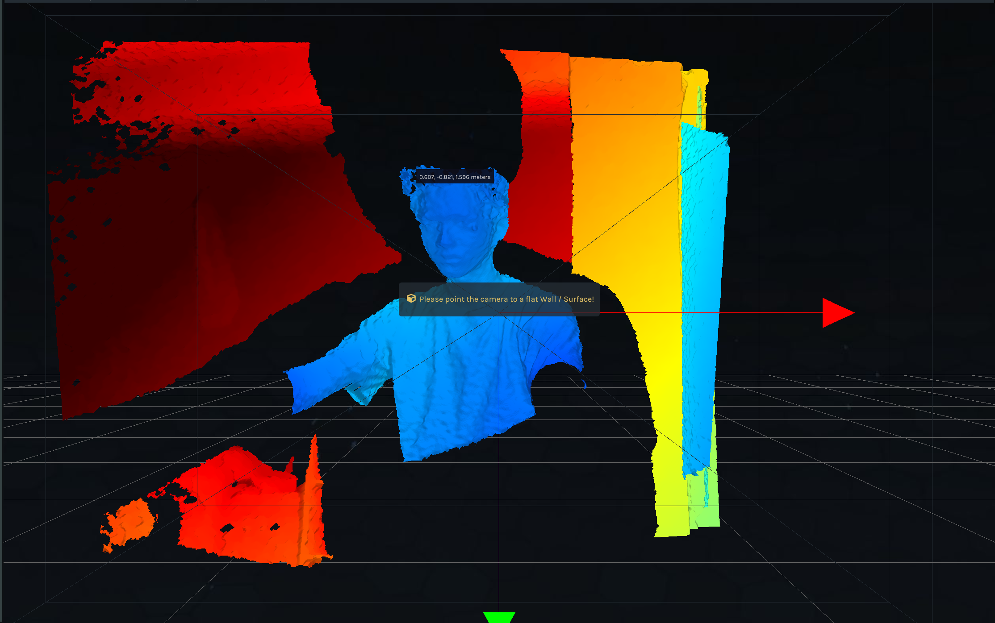
3D output from Realsense
Fig. 3D output from the realsense viewer
9

Slide 7
The End
THANK YOU FOR LISTENING
Thu Ta Zaw
2415121095

